Slide 1
B Trees

Slide 2
B Tree
B Tree is a specialized m-way tree that can be widely used for disk access.
A B-Tree of order m can have at most m-1 keys and m children.
One of the main reason of using B tree is its capability to store large number of keys in a single node and large key values by keeping the height of the tree relatively small.
A B tree of order m contains all the properties of an M way tree.
In addition, it contains the following properties.
Every node in a B-Tree contains at most m children.
Every node in a B-Tree except the root node and the leaf node contain at least m/2 children.
The root nodes must have at least 2 child nodes.
All leaf nodes must be at the same level.
It is not necessary that, all the nodes contain the same number of children but, each node must have m/2 number of child nodes.

Slide 3
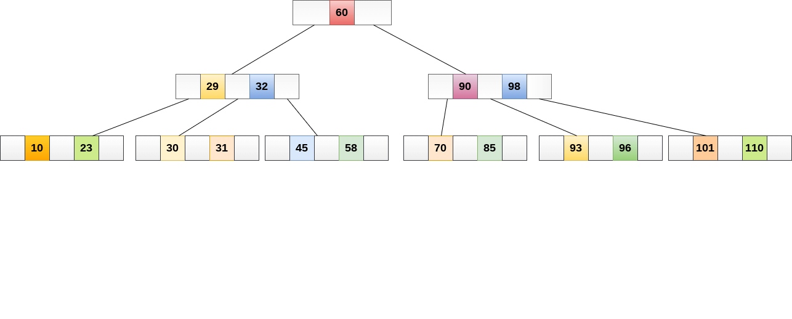
A B tree of order 4
While performing some operations on B Tree, any property of B Tree may violate.
such as number of minimum children a node can have.
To maintain the properties of B Tree, the tree may split or join.

Slide 4
Inserting
Insertions are done at the leaf node level.
Steps to insert an item into B Tree
Traverse the B Tree in order to find the appropriate leaf node at which the node can be inserted.
If the leaf node contain less than m-1 keys then insert the element in the increasing order.
Else, if the leaf node contains m-1 keys, then follow the following steps.
Insert the new element in the increasing order of elements.
Split the node into the two nodes at the median.
Push the median element upto its parent node.
If the parent node also contain m-1 number of keys, then split it too by following the same steps.

Slide 5
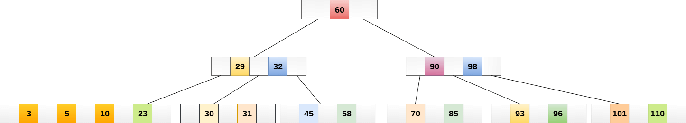
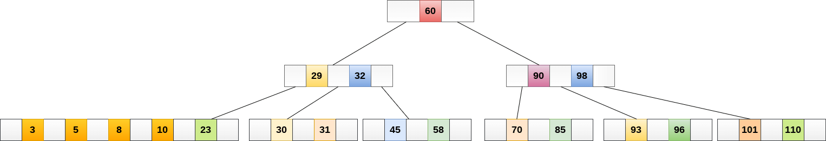
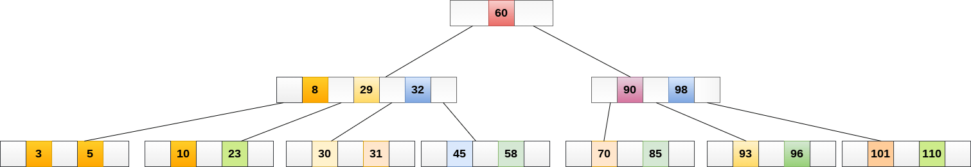
Example:
Insert the node 8 into the B Tree of order 5
8 will be inserted to the right of 5, therefore insert 8
The node, now contain 5 keys which is greater than (5 -1 = 4 ) keys.
Therefore split the node from the median i.e. 8 and push it up to its parent node shown as follows.

Slide 6
Illustrative Example
of
Inserting a Node in a
B tree

Slide 7
B-tree of order 4-
Insert 2, 6, 10, 20, 78, 5, 90, 25, 4, 80, 85,82

Slide 8






B-tree of order 4- Insert 2, 6, 10, 20, 78, 5, 90, 25, 4, 80, 85,82
2, 6, 10,
Insert 90
Insert 20
Insert 25
Insert 78, 5
Insert 4

Slide 9


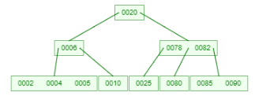
B-tree of order 4-
Insert 2, 6, 10, 20, 78, 5, 90, 25, 4, 80, 85,82
Insert 4
Insert 80
Insert 85
Insert 82

Slide 10
B-tree of order 4- Insert 2, 6, 10, 20, 78, 5, 90, 25, 4, 80, 85,82
Insert 2, 6, 10
Insert 25
Insert 20
Insert 85
Insert 4
Insert 78, 5
Insert 82
Insert 90
Insert 80

Slide 11
B-tree of order 4-
Insert 2, 6, 10, 20, 78, 5, 90, 25, 4, 80, 85,82

Slide 12
B-tree of order 3-
Insert 12, 16, 10, 20, 78, 15, 90, 25, 14, 80, 85,82

Slide 13
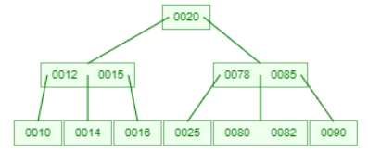
B-tree of order 3-
Insert 12, 16, 10, 20, 78, 15, 90, 25, 14, 80, 85,82

Slide 14
Deletion
Deletion is also performed at the leaf nodes.
The node to be deleted can either be a leaf node or an internal node.
Algorithm - to delete a node from a B tree
Locate the leaf node.
If there are m/2 keys in the leaf node then delete the desired key from the node.
If the leaf node doesn't contain m/2 keys then complete the keys by taking the element from right or left sibling.
If the left sibling contains m/2 elements then push its largest element up to its parent and move the intervening element down to the node where the key is deleted.
If the right sibling contains m/2 elements then push its smallest element up to the parent and move intervening element down to the node where the key is deleted.
Maintain
No. of child = ceil(M/2)
No. of keys = [ceil(M/2))]-1

Slide 15
If neither of the sibling contain m/2 elements then create a new leaf node by joining two leaf nodes and the intervening element of the parent node.
If parent is left with less than m/2 nodes then, apply the above process on the parent too.
If the node which is to be deleted is an internal node, then replace the node with its in-order successor or predecessor.
Note - successor or predecessor will be on the leaf node
Maintain
No. of child = ceil(M/2)
No. of keys = [ceil(M/2))]-1

Slide 16

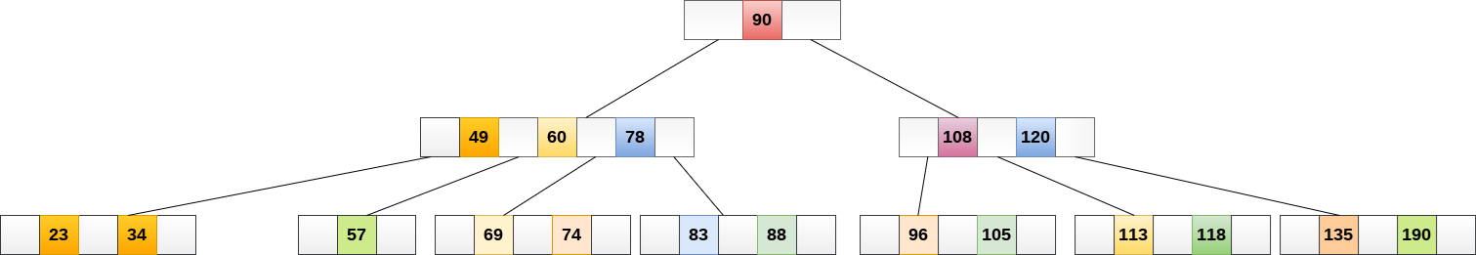
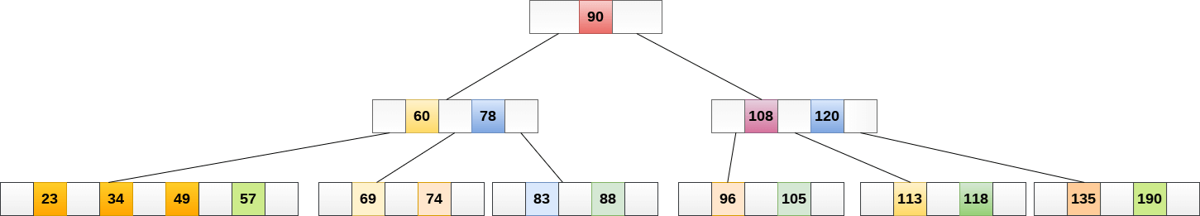
Delete the node 53 from the B Tree of order 5
53 is present in the right child of element 49. Delete it.
the minimum number of elements in a B tree of order 5, is 2.
Since, the elements in its left and right sub-tree are also not sufficient
therefore, merge it with the left sibling and intervening element of parent i.e. 49.
The final B tree will be

Slide 17
Illustrative Example
of
Deleting a Node in a
B tree

Slide 18
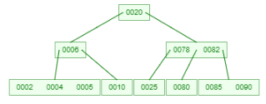
Btree of order 4 -Delete 82, 20, 78, 6, 85, 10
Maintain
No. of child = ceil(M/2)
No. of keys = [ceil(M/2))]-1

Slide 19
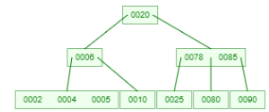
Btree of order 4 -Delete 82, 20, 78, 6, 85, 10
Maintain
No. of child = ceil(M/2)
No. of keys = [ceil(M/2))]-1
Delete 82

Slide 20
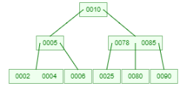
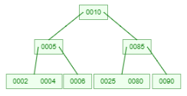
Delete 82, 20, 78, 6, 85, 10
Delete 20
Delete 78

Slide 21
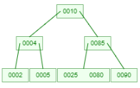
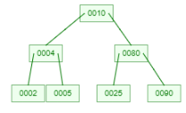

Delete 82, 20, 78, 6, 85, 10
Delete 6
Delete 85
Delete 10

Slide 22
Delete 82, 20, 78, 6, 85, 10
Delete 82
Delete 10
Delete 20
Delete 85
Delete 6
Delete 78

Slide 23
Delete 82, 20, 78, 6, 85, 10

Slide 24
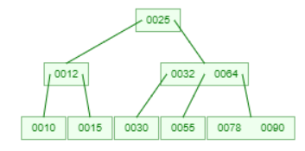
Btree of order 3 -Delete 25, 15, 32, 64, 12
Maintain
No. of child = ceil(M/2)
No. of keys = [ceil(M/2))]-1

Slide 25
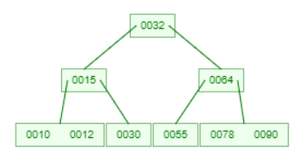
Btree of order 3 -Delete 25, 15, 32, 64, 12
Delete 25

Slide 26
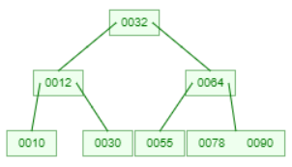
Btree of order 3 -Delete 25, 15, 32, 64, 12
Delete 15

Slide 27
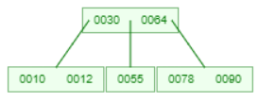
Btree of order 3 -Delete 25, 15, 32, 64, 12
Delete 32

Slide 28
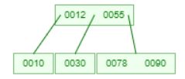
Btree of order 3 -Delete 25, 15, 32, 64, 12
Delete 64

Slide 29
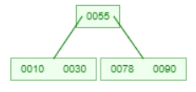
Btree of order 3 -Delete 25, 15, 32, 64, 12
Delete 12

Slide 30
Btree of order 3 -Delete 25, 15, 32, 64, 12
Delete 25
Delete 15
Delete 32
Delete 64
Delete 12

Slide 31
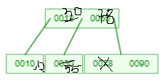
Alternative Delete 64

Slide 32
Application of B tree
B tree are balanced search tree designed to work well on magnetic disk or other direct access secondary storage devices
B tree is used to index the data and provides fast access to the actual data stored on the disks
Searching an un-indexed and unsorted database containing n key values needs O(n) running time in worst case. However, if we use B Tree to index this database, it will be searched in O(log n) time in worst case.
B tree help in minimizing the disk I/O operations
Many databases uses B Tree or variants of B Tree such as B+ or B* to store information

Slide 33
Video Lectures can be found at following link
M way Search tree
https://youtu.be/PHJY8EsyOlU
B Tree
https://youtu.be/Or7BViYrov0
Illustrative Examples of Deleting a Node in a B tree
https://youtu.be/e2dOJpKtX2I
Illustrative Examples of Inserting a Node in a B tree
https://youtu.be/jYPgFWTPaMQ

